Slide 1
Student test score analysis and prediction
By Luki Prasetyo

Slide 2
Predicting math score based on pHysics, Science and statistics score
Total Number of Students: 466
Descriptive Statistics
 | Count | Mean | Std dev | Min | Q1 | Q2 | Q3 | Max
Physics | 466 | 71.2 | 16.0 | 0.0 | 66.0 | 74.0 | 82.0 | 99.0
Science | 466 | 72.8 | 14.3 | 0.0 | 66.0 | 74.0 | 82.0 | 99.0
Statistics | 466 | 73.6 | 12.2 | 22.0 | 66.25 | 74.0 | 82.0 | 100
Math | 466 | 74.5 | 11.4 | 22.0 | 67.0 | 74.0 | 83.0 | 99.0

Slide 3
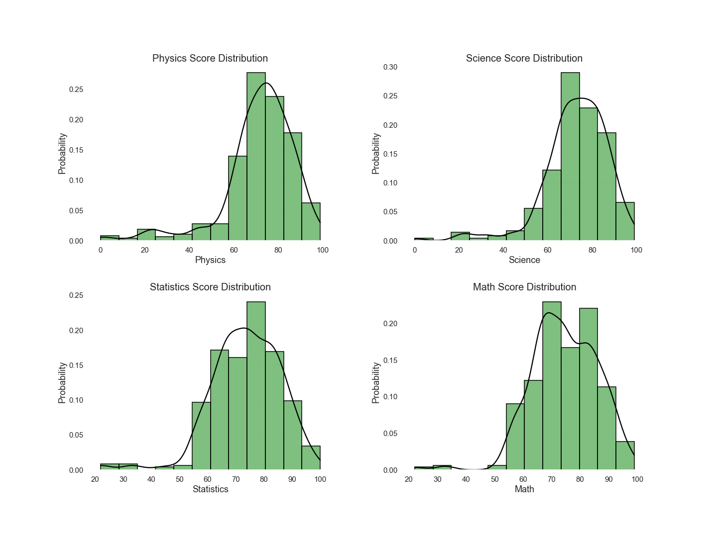
Distribution student test score
The distribution is skewed to the left.
Skewness
Physics : -1.664994
Science : -1.443609
Statistics : -0.849626
Math : -0.561298

Slide 4
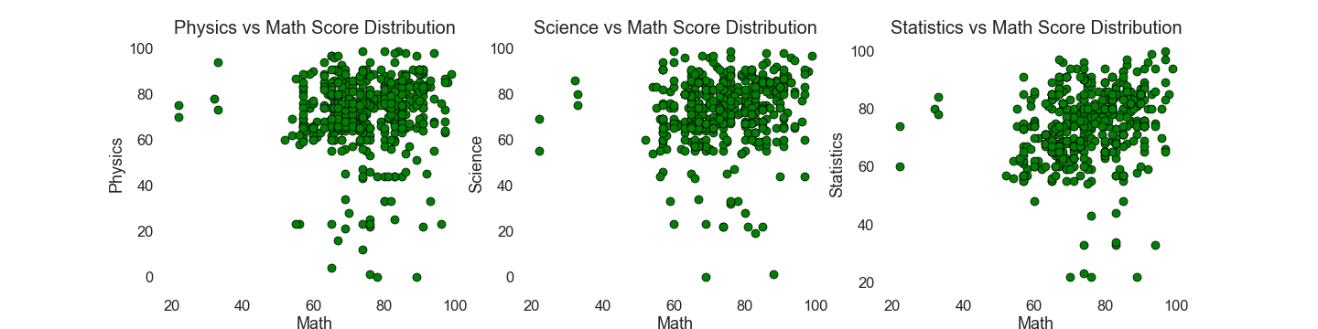
Scatter plot student test score
From the scatter plot below, we can assume that the data has an insignificant correlation, based on the nodes that that appear to have no linear relationship.
We can find the correlation using Pearson coefficient

Slide 5
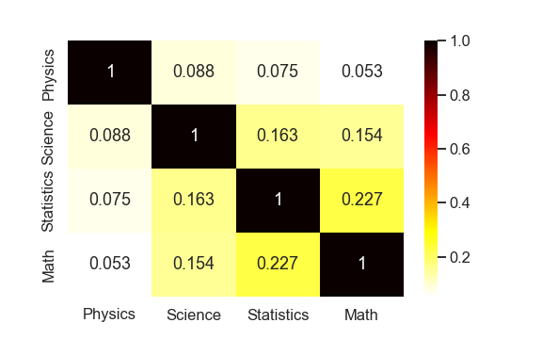
Correlation between student test score
Because we want to predict math score based on other score, so math score is dependent variable (DV) and other score is independent variable (IV)
From the image we can see the correlation between IV and DV are insignificance.

Slide 6
Choosing model
Model: Random Forest Regression.
Outlier will be dropped.
We want to predicting numeric score based on other score, so we will use regression. Because based on the correlation and scatter plot we can see, the data is non-linear, so linear regression will be bad idea, Then we will choose non-linear regression algorithm. In here we choose Random Forest Regression, because Random Forest Regression can capture non-linearity in data and better than decision tree.
From the scatter plot we can see many outliers, we can drop the outliers or capping/flooring the outliers. Here outliers will be dropped because the data does not have many samples, and outliers will make the accuracy worst, but if outliers are dropped, there are negative consequences or effects such as can cause bias and/or affect estimates.

Slide 7
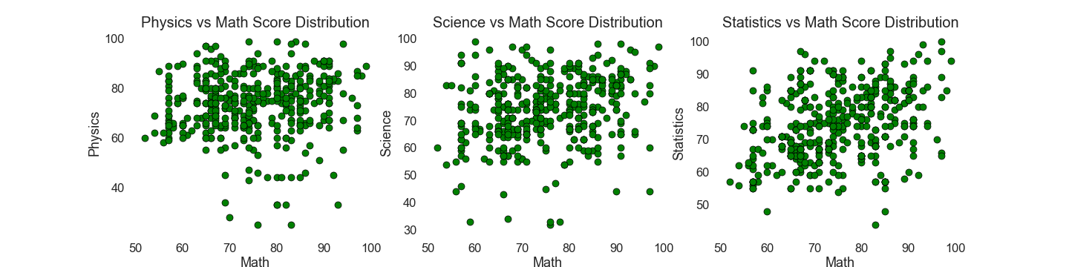
Remove outliers
Since we have near normal distribution we can and will use Z-score method to detect and deal with outliers.
In a normally distributed data 95% of the data lie within +/- 3 standard deviation.
So we treat data which are outside of +/- three standard deviations as outliers.
 | LCB | UCB
Physics | 23.64 | 119.84
Science | 30.00 | 115.62
Statistics | 37.14 | 110.22
Math | 40.27 | 108.81
After removing 36 outlier, we now have 430 data of student test score, and we can see the plot below

Slide 8
Developing the model
First, we will split the data for training and test/validation using train_test_split from scikit-learn
With training size is 80% and test size is 20%
And the x variable or IV or predictor is Physics, Science and Statistics
And the y variable or DV is Math Score
Second, after we split the data, then we tuning the hyper parameter to optimize the performance of Random Forest Regression. IN Random Forest the hyper parameters include the number of decision trees in the forest and the number of features considered by each tree when splitting a node. In here we use Random Search Cross Validation from scikit-learn
Random Search Cross Validation or RandomizedSearchCV, we can define a grid of hyper parameter range, and randomly sample from the grid, then performing K-Fold CV with each combination values.

Slide 9
Tuning hyper parameter
Parameters
Number of tree on random forest : 200, 400, 600, 800, … , 2000
Number of features to consider at every split : auto or square root (sqrt)
Maximum number of levels in tree : 10, 20, 30, 40, … , 120
Minimum number of samples required to split a node : 2, 5, 10
Minimum number of samples required at each leaf node : 1, 2, 4, 5, 10
Method of selecting samples for training each tree : True or False
Cross Validation (K-Fold) : 5 Folds
Iteration : 100
After tuning the hyper parameter we find the best parameters are:
Best Parameters
Number of tree on random forest : 200
Number of features to consider at every split : square root (sqrt)
Maximum number of levels in tree : 80
Minimum number of samples required to split a node : 2
Minimum number of samples required at each leaf node : 2
Method of selecting samples for training each tree : True

Slide 10
TRAINING RANDOM FOREST REGRESSION
After choose the best parameters, then apply the parameters and run the model
After running the model, and choose metrics for checking the accuracy, using:
R2
Mean Absolute Percentage Error
Using MAPE because it is easy to interpret, because it use percentage
The result is:
 | Train | Test
R2 Score | 0.6134 | 0.2013
MAPE | 7.14 % | 10.34 %
Accuracy | 92.86 % | 89.66 %
The model accuracy (judged by the r-squared and MAPE) is not very high. But this was kind of expected as the features we have are not highly predictive of test score.
Test performance may depend on more features than given in this dataset. Therefore, more features are required to accurately identify what affects student's' test score.

Slide 11
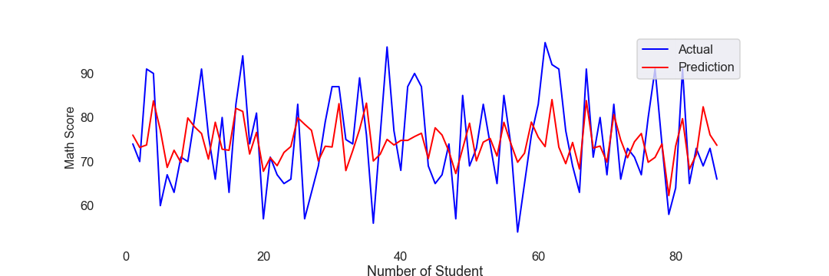
PREDICTING SCORE BASED ON TEST DATA
Actual | Predicted | Different
74 | 76.00 | -2.00
70 | 73.20 | -3.20
91 | 73.77 | 17.23
90 | 83.78 | 6.22
60 | 77.14 | -17.14
67 | 68.66 | -1.66
63 | 72.56 | -9.56
71 | 69.77 | 1.23
70 | 79.90 | -9.90
80 | 77.85 | 2.15
From the table and the plot above, we can see the prediction is not good enough, because it’s hard to predict numeric score if the predictor or feature is not good to be predictor, and coupled with small sample size.

Slide 12
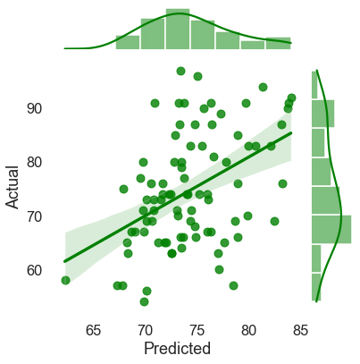
PREDICTING SCORE BASED ON TEST DATA
From the image, we can see the regression is not good enough, because so many data outside the regression boundaries.

Slide 13
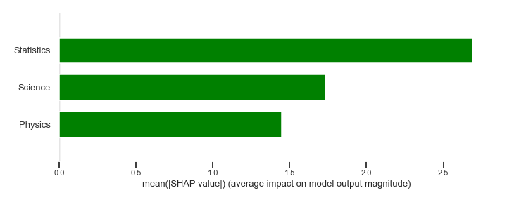

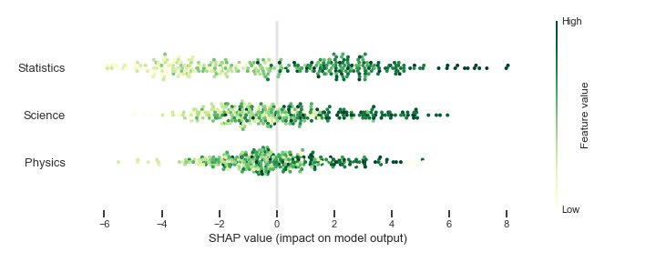
Feature importance using shap
As you can see from the SHAP summary, Statistics has a bigger impact than any other feature, if we look at the correlation between math and statistics it has the highest correlation value among other features.

Slide 14
Conclusions
Exploratory Data Analysis
The data is have normal distribution but skewed to the left.
Correlation between IV and DV are small or insignificant
Model Building
Using Random Forest Regression, because it’s good for non-linear data, and predicting numeric values.
Removing outlier, because we have small sample data (outlier will affect the accuracy).
Splitting the data with test data 20% from sample data.
Tuning the hyper parameters to find the best values of parameters.
Running the Model
We got low r-square and accuracy score for training and test data, because the sample are to small and the feature/predictor is not good enough for predicting.
Choosing MAPE for checking the accuracy, because MAPE is best for interpretation, because using percentage and everyone will understand better.
Finding feature importance using SHAp

Slide 15
Model fEATURES Summary
Good Parts
If we want to predict numeric score when there is no linear relationship, or have small correlation, we can use Random Forest Regression.
Random Forest Regression is better than decision tree for predicting non-linear data.
In this model, the accuracy is not that bad, considering the data size is small, and the feature or independent variable is not good enough as predictor.
Using hyper parameters tuning to find best parameters for the model, and using cross validation.
This model is easy to understand and perform faster, although the data size is small.
Improvable parts
Find other feature/predictor that would impact the score, like study hour per week or IQ-level, and many more. Because the current feature are not sufficient to pinpoint what factors affect students’ performance.
Try other regression model that work better for non-linear data, like Gradient Boosting Regressor, Extra Tree Regressor, ElasticNET or XGBRegressor, then tuning their hyper parameters to see what model is the best.
Tuning hyper parameters using other technique, like Grid Search with Cross Validation, after we know the best parameters from Random Search, and we can narrow the range for each hyper parameter, and can concentrate searching best parameters.

